Slide 1
WiFi Booster Impact
Stanislav Babenyshev
19.06.2026

Slide 2

Executive Summary: Targeted rollout unlocks CHF +20.7M
Recommendation
✓ Roll out booster to Extreme internet users
✗ Do not extend to full customer base
✓ Validate with a randomized A/B test before scaling
 | Cost | Saved rev. | Net
Extreme users | CHF 8.7M | CHF 29.4M | CHF +20.7M
Full base | CHF 52.5M | CHF 30.5M | CHF −22.0M
Extreme users capture 96% of the saved revenue at 17% of the cost.

Slide 3
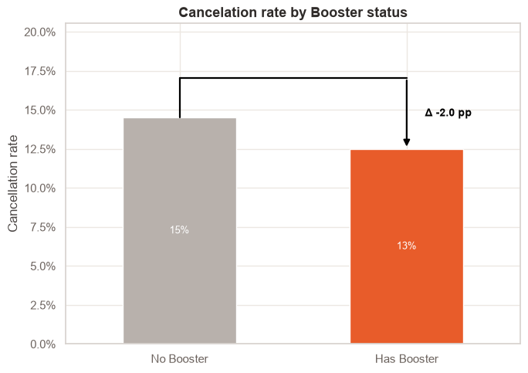
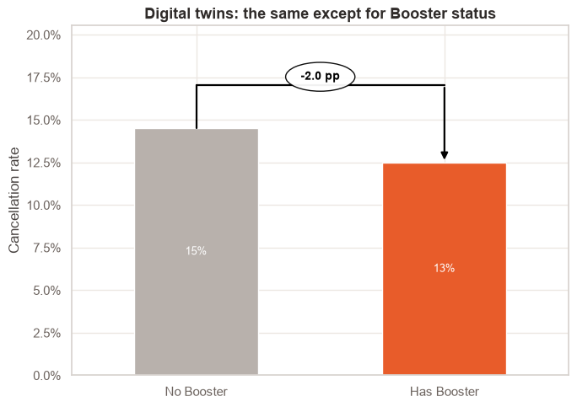
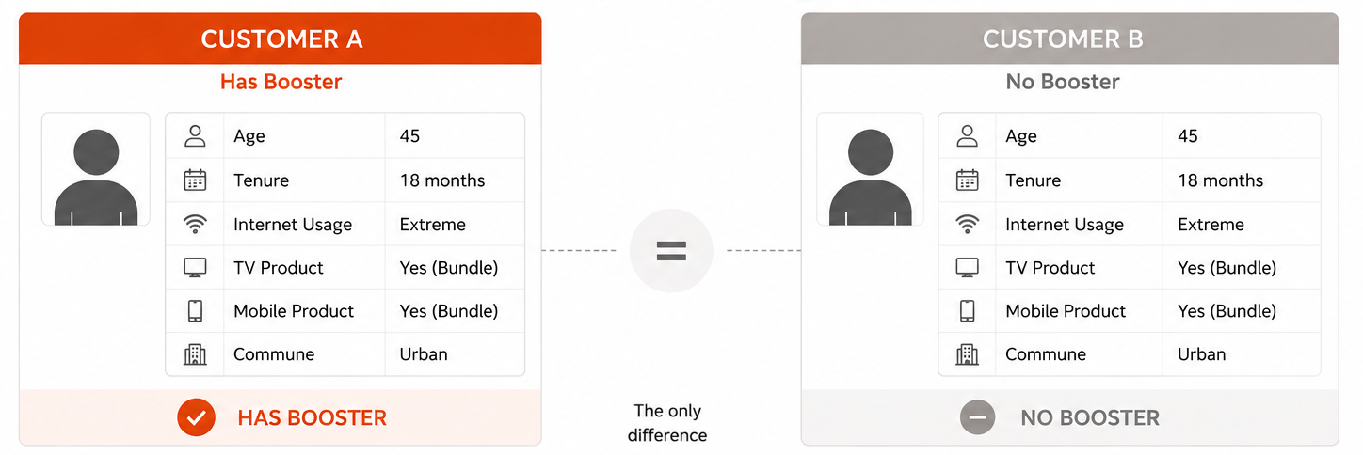
How much does the booster reduce cancelation?
Overall comparison
Raw averages — does not correct for self-selection
Corrected (“Like-for-like”) comparison
Two independent methods cross-check the estimate
Logistic Regression (AME): −1.0 pp
Digital Twins (PSM, ATT): −1.6 pp
Two independent methods confirm: the booster effect is real, but substantially smaller than raw comparisons suggest.

Slide 4
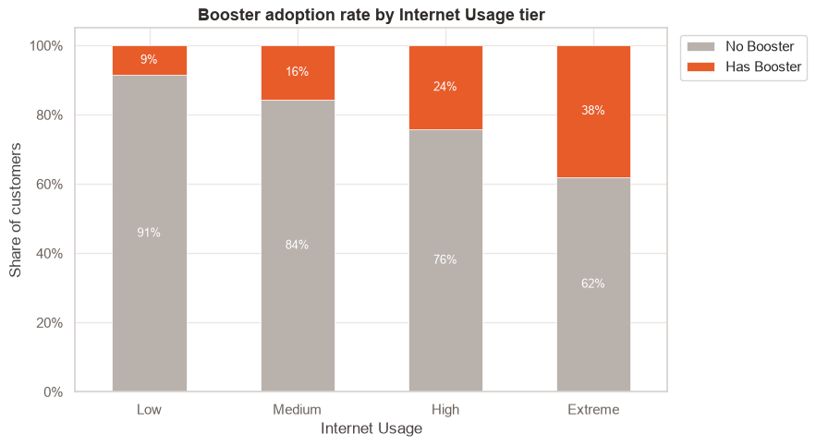
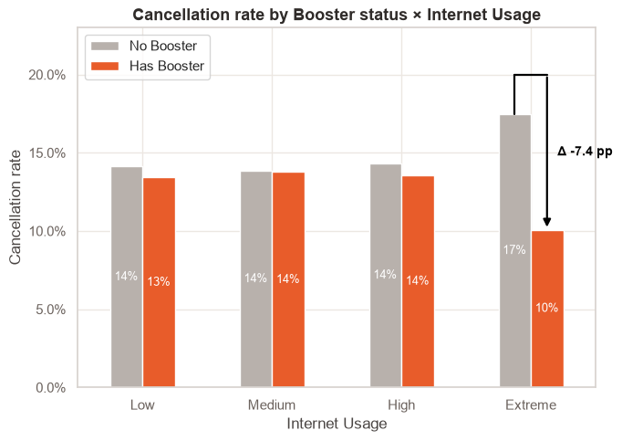
Heavy users self-select into the booster
The apparent overall benefit comes mostly from the fact that heavy users choose the booster.
Raw comparison is misleading — heavy users self-select into the booster, inflating expected benefit.

Slide 5
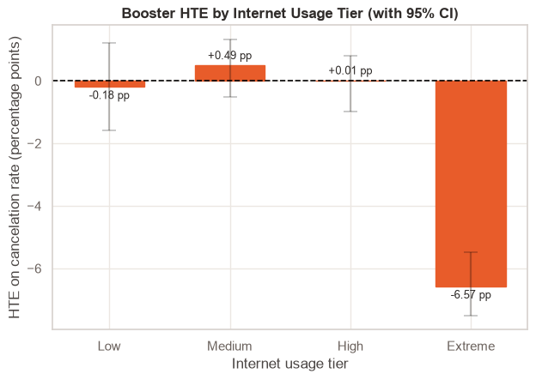
Extreme internet users drive the entire booster effect
HTE (Heterogeneous Treatment Effect) answers: “For a customer with specific characteristics, how much does a cancelation probability change if that customer has or has not a booster, while everything else stays the same?”
Segment | Customers | AME
Low usage | 24% | −0.2 pp
Medium usage | 34% | +0.5 pp
High usage | 28% | 0.0 pp
Extreme usage | 17% | −6.6 pp
Only Extreme internet users show a statistically significant effect — the other segments show no meaningful cancelation rate reduction.

Slide 6
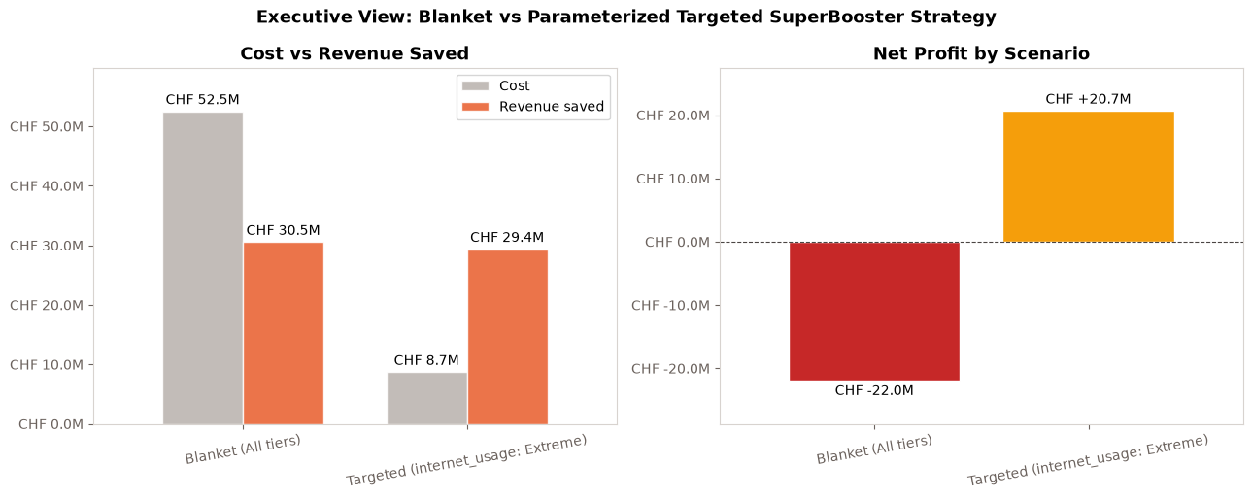
Targeted vs. blanket: CHF +20.7M vs. CHF −22M

Slide 7
Appendix: EDA

Slide 8
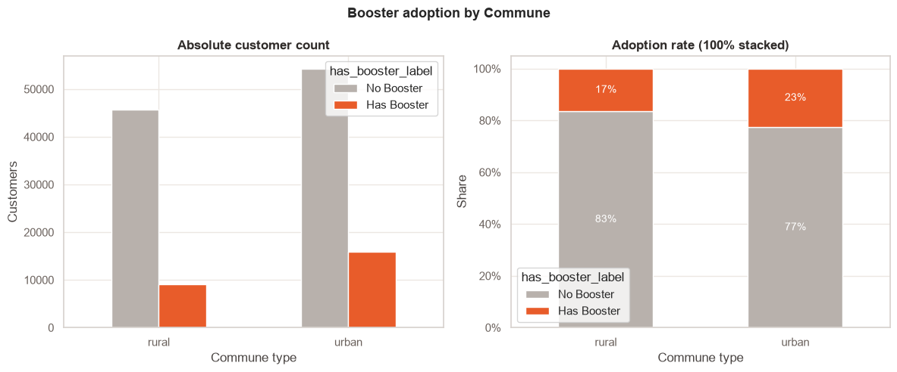
Booster Adoption: urban vs rural
Urban customers request it more than rural

Slide 9
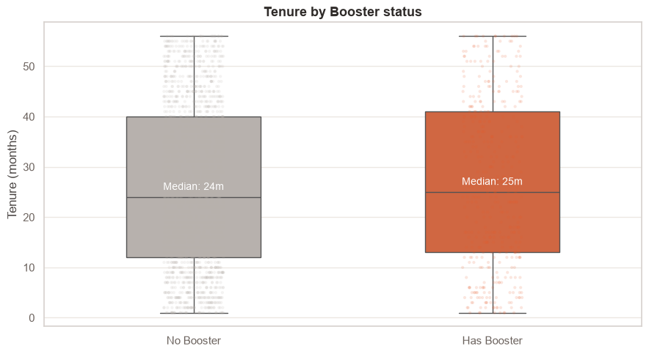
Tenure Distributions: Booster vs No-booster
Booster adopters have similar tenure

Slide 10
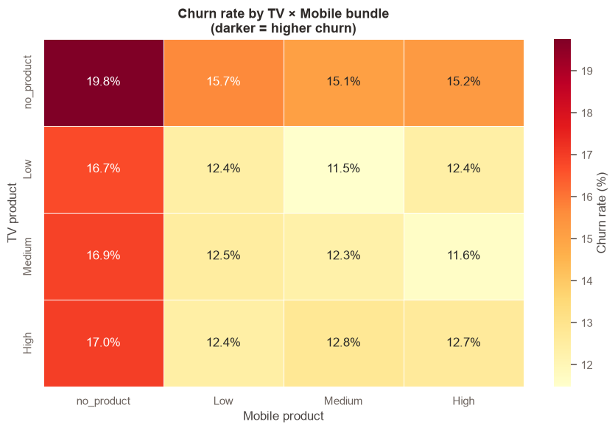
Bundle Stickiness: Cancelation rate by TV × Mobile product
No-bundle customers cancel at 20%, vs 12% for bundled (golden handcuffs)

Slide 11
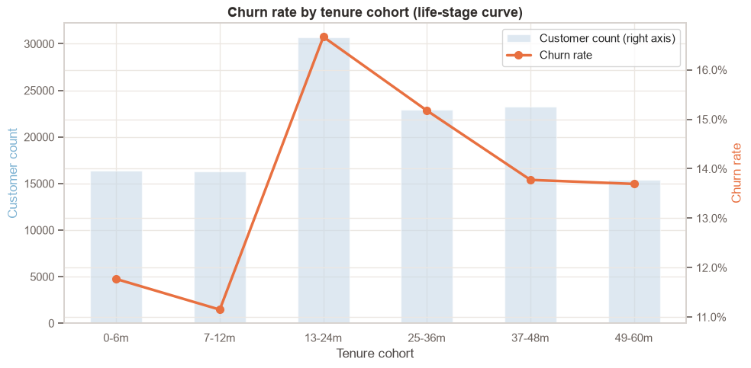
Tenure cohorts vs cancelation rate (life-stage curve)
Cancelation peaks 13–24 months then falls (tenure effect)

Slide 12
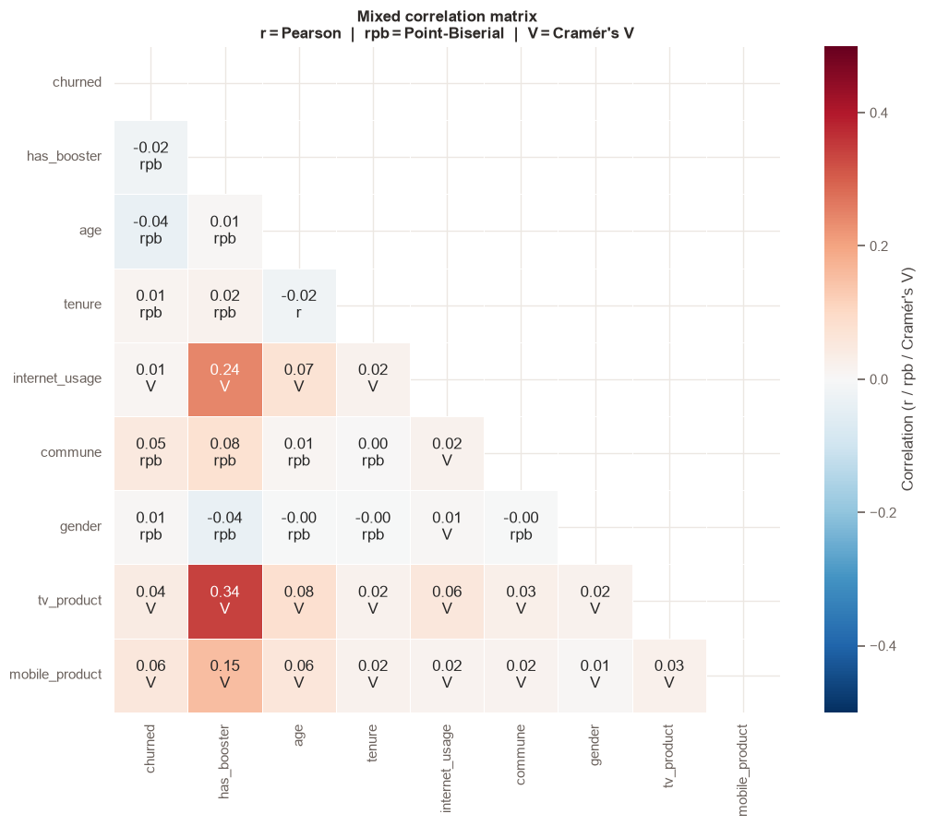
Data Health: Mixed correlation heatmap
Has_booster ↔ tv_product V=0.34, the key confounder for the logistic model

Slide 13
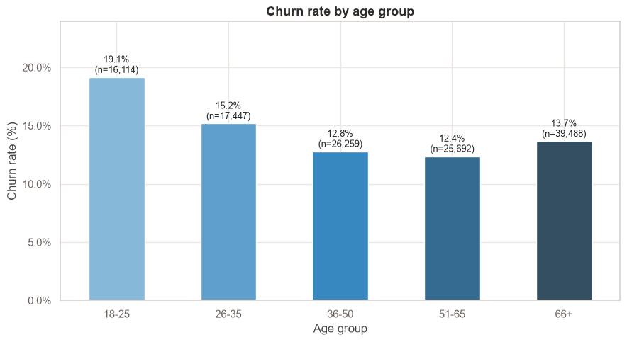
Non-linear churn by life stage: Cancelation peaks for young customers
U-shaped churn curve — young customers (18–25: 19.1%) churn most, drops sharply to 51–65 (12.4%), then rises slightly at 66+ (13.7%). The age_group dummy approach is preferable.

Slide 14
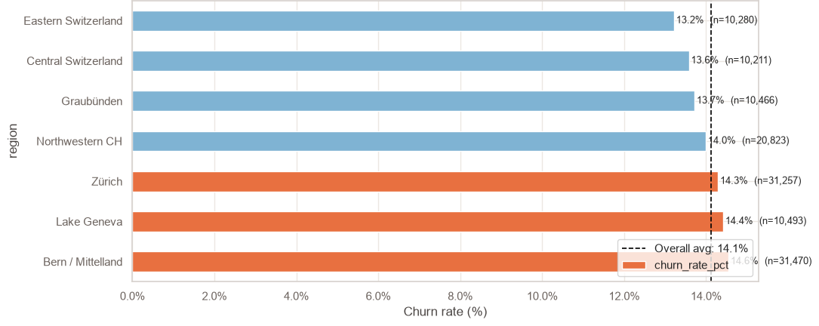
Regional Churn: Average cancelation rate by Swiss region
Bern/Mittelland (14.6%), Lake Geneva (14.4%), and Zürich (14.3%) are above the 14.1% average; Eastern Switzerland (13.2%) and Central Switzerland (13.6%) are below. Regional variation is modest (~1.4pp range) but real.

